Slide 1


MindSense AI
AI-Powered Mental Health Risk Prediction using Explainable AI
Developed During Internship at Digital Ipsum Ltd.
Presented by Musharraf Bubere
Digital Ipsum Ltd.
MindSense AI 01

Slide 2

Agenda
Introduction & Problem Statement
System Objectives
Existing vs Proposed System
Technology Stack & Architecture
Machine Learning & XAI (SHAP)
Project Demonstration
Challenges & Future Scope
Digital Ipsum Ltd.
MindSense AI 02

Slide 3






Introduction to MindSense AI
MindSense AI is an intelligent, web-based platform designed to predict mental health risks using Machine Learning while providing transparent explanations through Explainable AI (SHAP).
AI Prediction
SHAP Explanations
Actionable Insights
Utilizes Logistic Regression algorithms to accurately assess mental health risk levels based on user data.
Demystifies AI decisions by showing exactly which factors contributed to a specific risk prediction.
Generates personalized recommendations, interactive dashboard analytics, and downloadable PDF reports.
Digital Ipsum Ltd.
MindSense AI 03

Slide 4
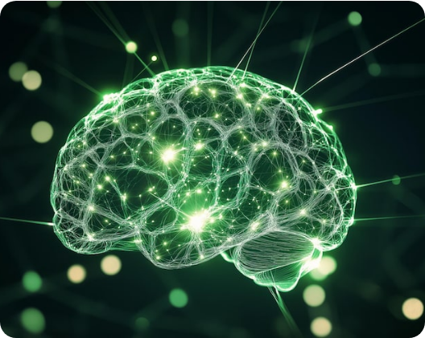
Problem Statement & Objectives
The Problem
Traditional mental health assessments are often manual, time-consuming, and lack system-level transparency (the "Black Box" problem).
Core Objectives
Deliver instant risk predictions.
Explain predictions clearly using SHAP.
Generate tailored wellness recommendations.
Provide interactive dashboard visualization.
Digital Ipsum Ltd.
MindSense AI 04

Slide 5


System Comparison
Existing Systems
Proposed MindSense AI
Highly manual processes requiring extensive intervention.
Automated AI predictions for immediate triage.
Slow turnaround times for generating assessments.
Fast, highly optimized risk calculation.
Clear SHAP explanations demystifying the model.
"Black box" results with no explanation of logic.
Interactive dashboards for continuous monitoring.
Lack of dynamic, interactive progress tracking.
Digital Ipsum Ltd.
MindSense AI 05

Slide 6

Technology Stack
Frontend
Machine Learning
HTML, CSS, Bootstrap, JavaScript for responsive UI.
Scikit-learn, featuring Logistic Regression models.
Backend Server
Explainable AI (XAI)
Built robustly on Python using the Flask framework.
SHAP library for comprehensive feature importance.
Database Storage
SQLite for lightweight, secure assessment history.
Data Visualization & Export
Chart.js for interactive dashboards, ReportLab for PDFs.
Digital Ipsum Ltd.
MindSense AI 06

Slide 7





System Workflow
Assessment
Validation
Prediction
Explanation
Delivery
User completes multi-step health form.
Flask app sanitizes & processes input.
ML model calculates risk probability.
SHAP identifies key contributing factors.
Dashboard updates & PDF generated.
Digital Ipsum Ltd.
MindSense AI 07

Slide 8

Machine Learning & Explainable AI
Logistic Regression Model
Utilizes binary classification optimized for clinical data metrics:
Accuracy
F1 Score
Precision
ROC-AUC
Recall
The SHAP Advantage
SHAP (SHapley Additive exPlanations) breaks the "black box" by calculating the specific impact of every single feature on a given prediction, ensuring Transparency, Trust, and Interpretability.
Digital Ipsum Ltd.
MindSense AI 08

Slide 9

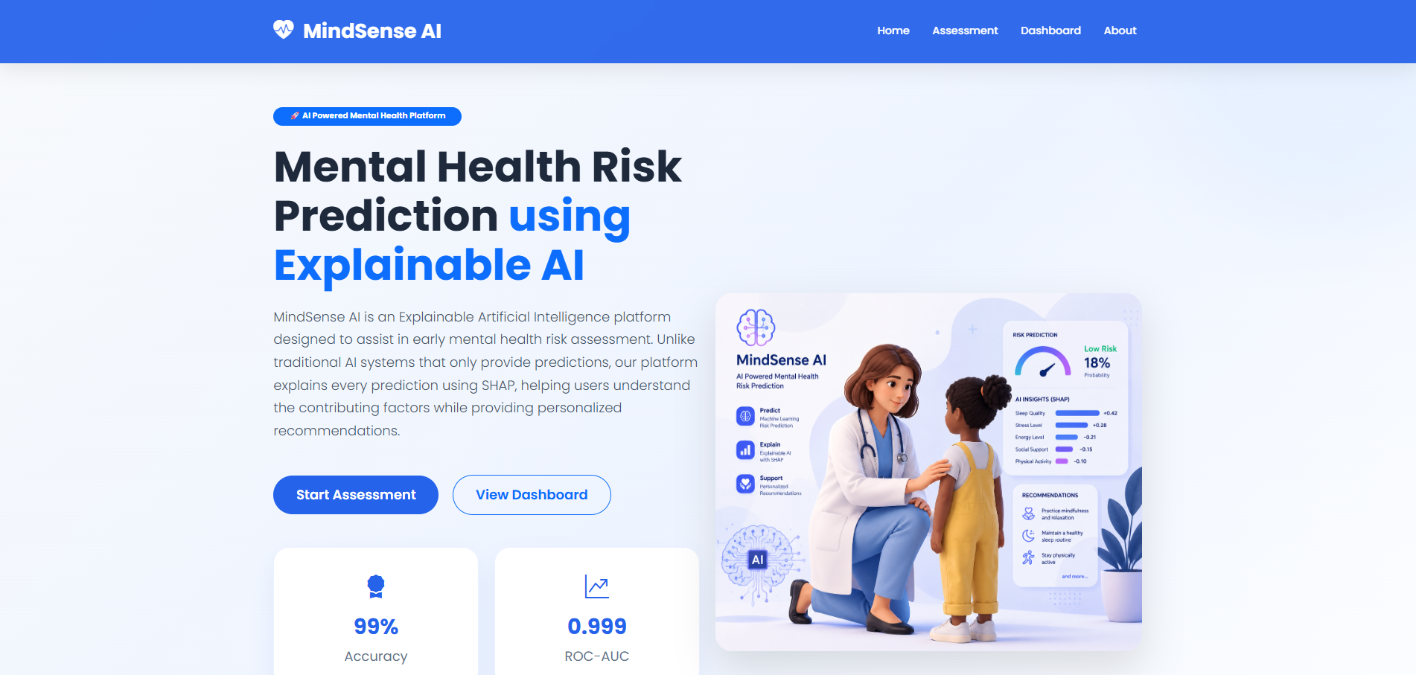





Platform Demonstration: Home Page
Digital Ipsum Ltd.
MindSense AI 09

Slide 10
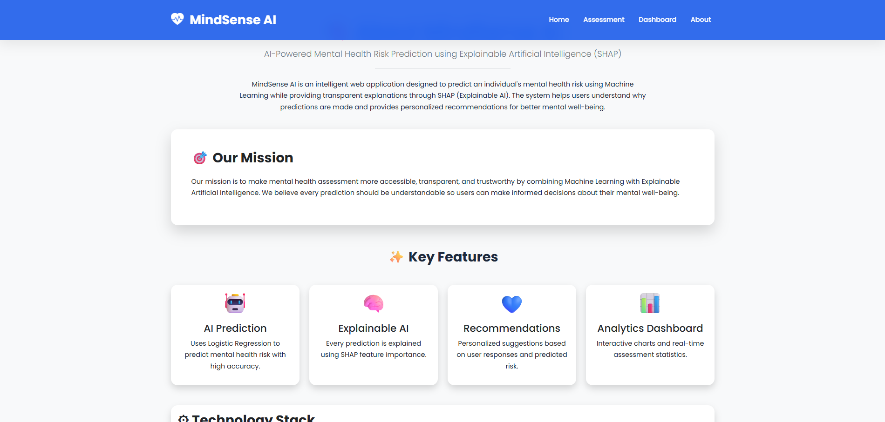




Platform Demonstration: About Section
Digital Ipsum Ltd.
MindSense AI 10

Slide 11
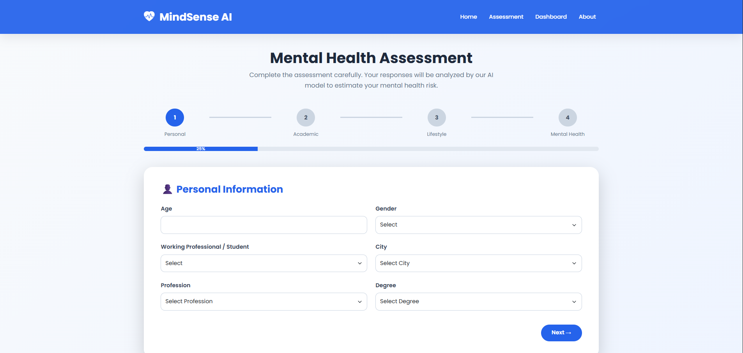




Platform Demonstration: Assessment
Digital Ipsum Ltd.
MindSense AI 11

Slide 12
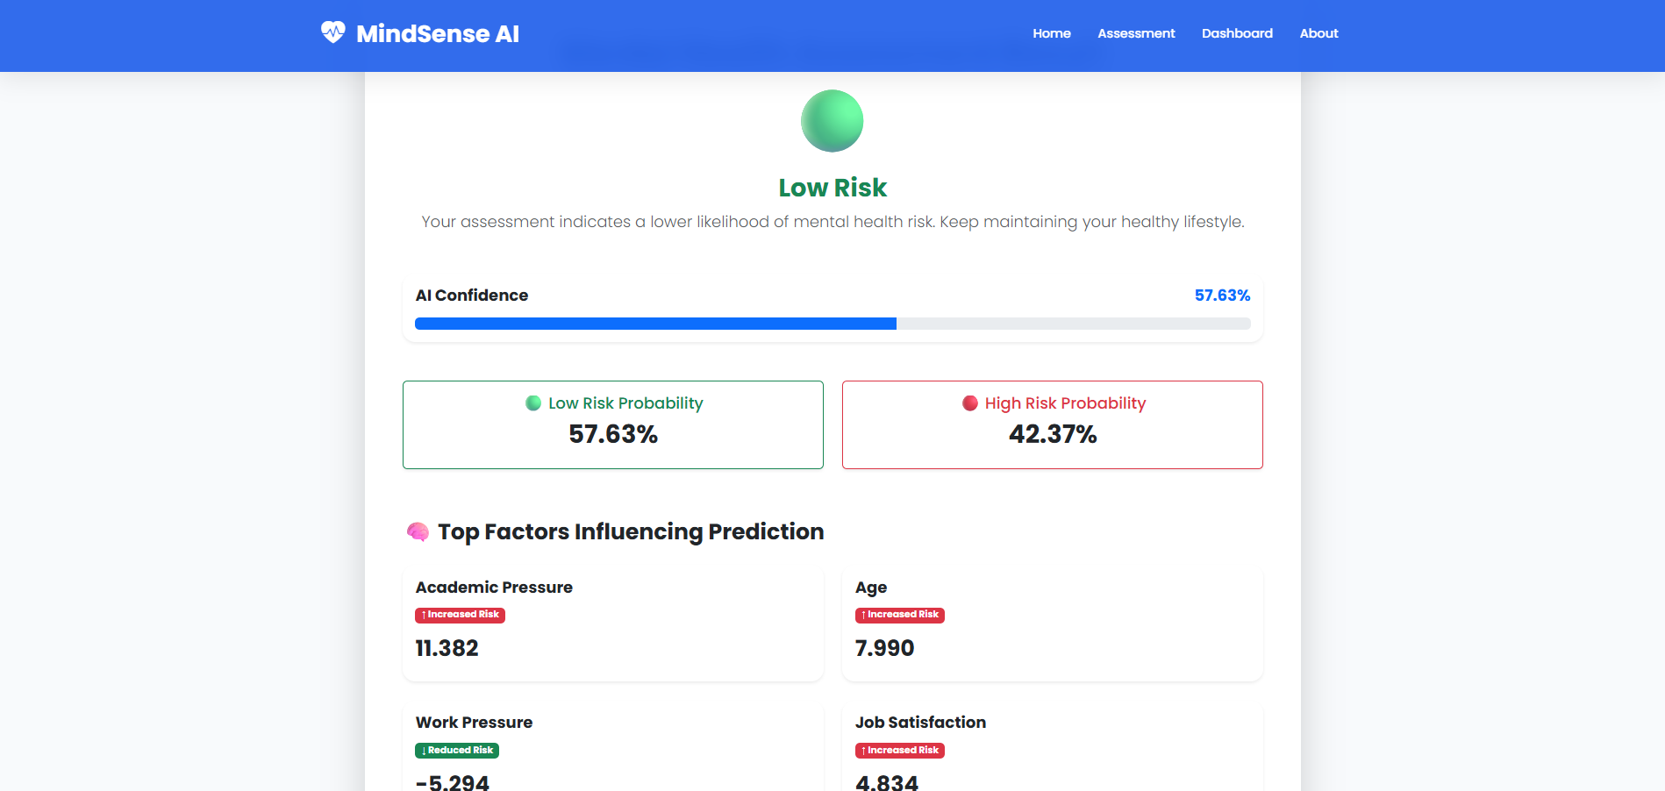




Platform Demonstration: Results
Digital Ipsum Ltd.
MindSense AI 12

Slide 13
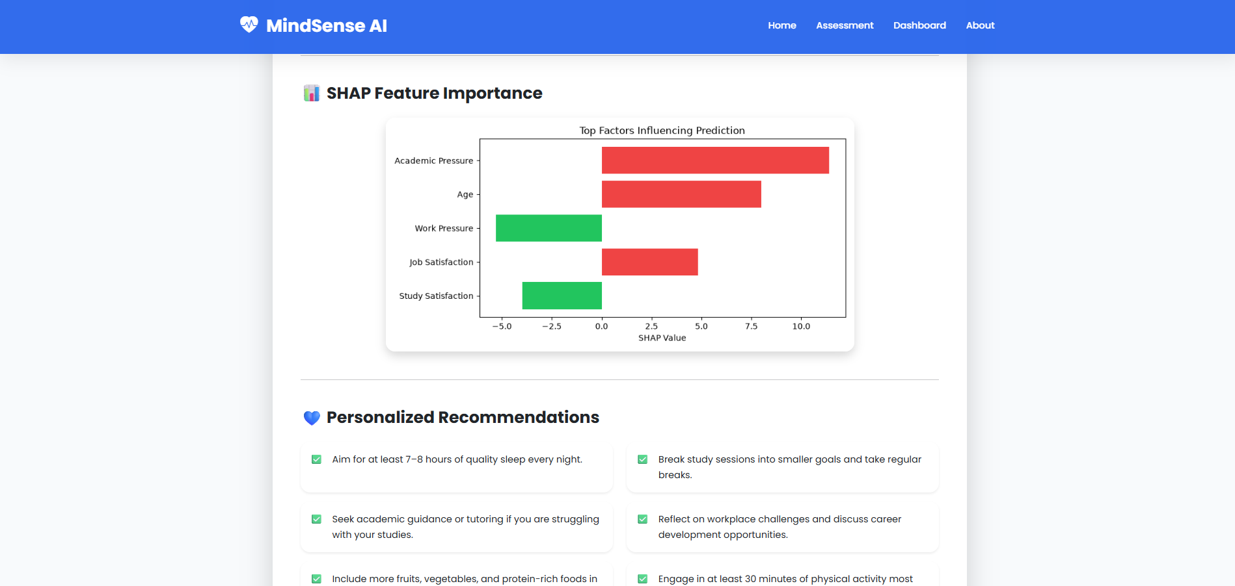




Platform Demonstration: SHAP
Digital Ipsum Ltd.
MindSense AI 13

Slide 14
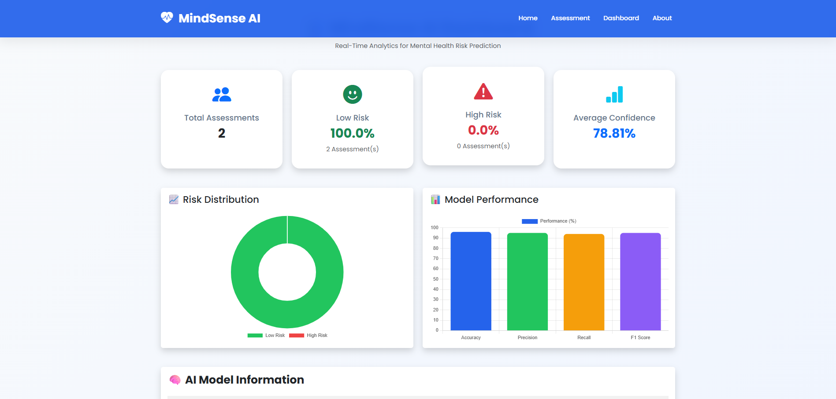




Platform Demonstration: Dashboard
Digital Ipsum Ltd.
MindSense AI 14

Slide 15

Challenges Faced During Development
Developing a comprehensive, AI-driven mental health platform introduced several key technical and structural challenges:
Interactive Dashboard: Mapping real-time Chart.js visuals with the SQLite database.
Data Preprocessing: Handling and cleaning complex clinical datasets.
Report Generation: Formatting dynamic and structured PDF exports with ReportLab.
Feature Engineering: Optimizing variables for the Logistic Regression model.
Testing & Debugging: Ensuring high predictive accuracy and overall system stability.
Integrating SHAP: Generating readable UI explanations from the ML backend.
Responsive Interface: Building a seamless Flask UI across all devices.
Digital Ipsum Ltd.
MindSense AI 15

Slide 16


Project Evolution
Current Achievements
Future Enhancements
Seamless Flask Application integration.
Transitioning to Deep Learning networks.
Successful deployment of ML & SHAP models.
Native Mobile App development (iOS/Android).
Interactive Dashboard & PDF Generation.
Specialized Doctor Dashboard for clinical review.
Stable SQLite architecture.
Cloud Deployment (AWS/Azure) with Auth.
Responsive, accessible User Interface.
Conversational AI Chatbot for triage.
Digital Ipsum Ltd.
MindSense AI 16

Slide 17

Questions & Discussion
MindSense AI demonstrates how Machine Learning and Explainable AI can work together to create transparent, accurate, and user-friendly mental health risk assessment systems. The project combines predictive analytics with interpretable AI, helping users understand not only the prediction but also the reasoning behind it.
Musharraf Bubere
Digital Ipsum Ltd.
Digital Ipsum Ltd.
MindSense AI 17

